Slide 1


Explainable AI for NFL game predictions
Anton Crazzolara, Marco Heiniger, Luis Knufinke

Slide 2
Research Question
What types of visualizations are the most appropriate for explaining predictions of NFL games based on machine learning methods?
Notes:
Explain that we wanted to do something about explainable AI and as Luis is a big american football fan he proposed this.

Slide 3
Procedure
Data collection (Kaggle)
Data cleaning & extension
Model evaluation (logistic regression & XGboost)
Accuracy of 77% on test set for both models
Visualization of results
Online survey

Slide 4
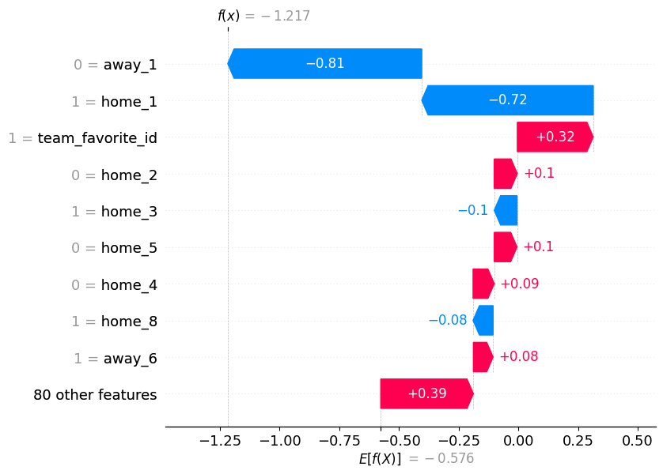
Logistic Regression & Local SHAP Values
Average Rating
2.05/5.00

Slide 5
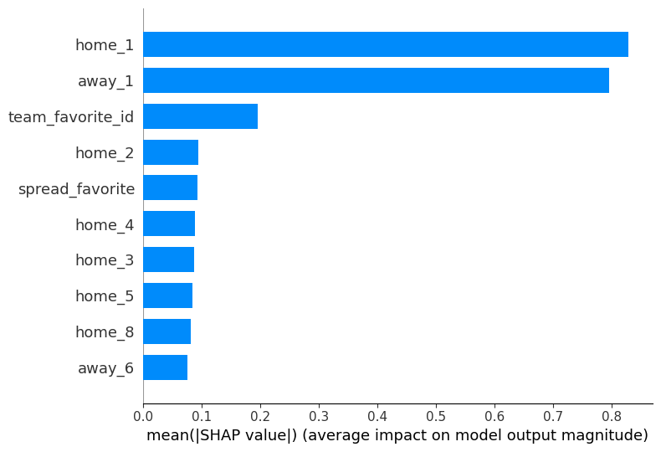
Logistic Regression & Global SHAP Values
Average Rating
2.50/5.00

Slide 6
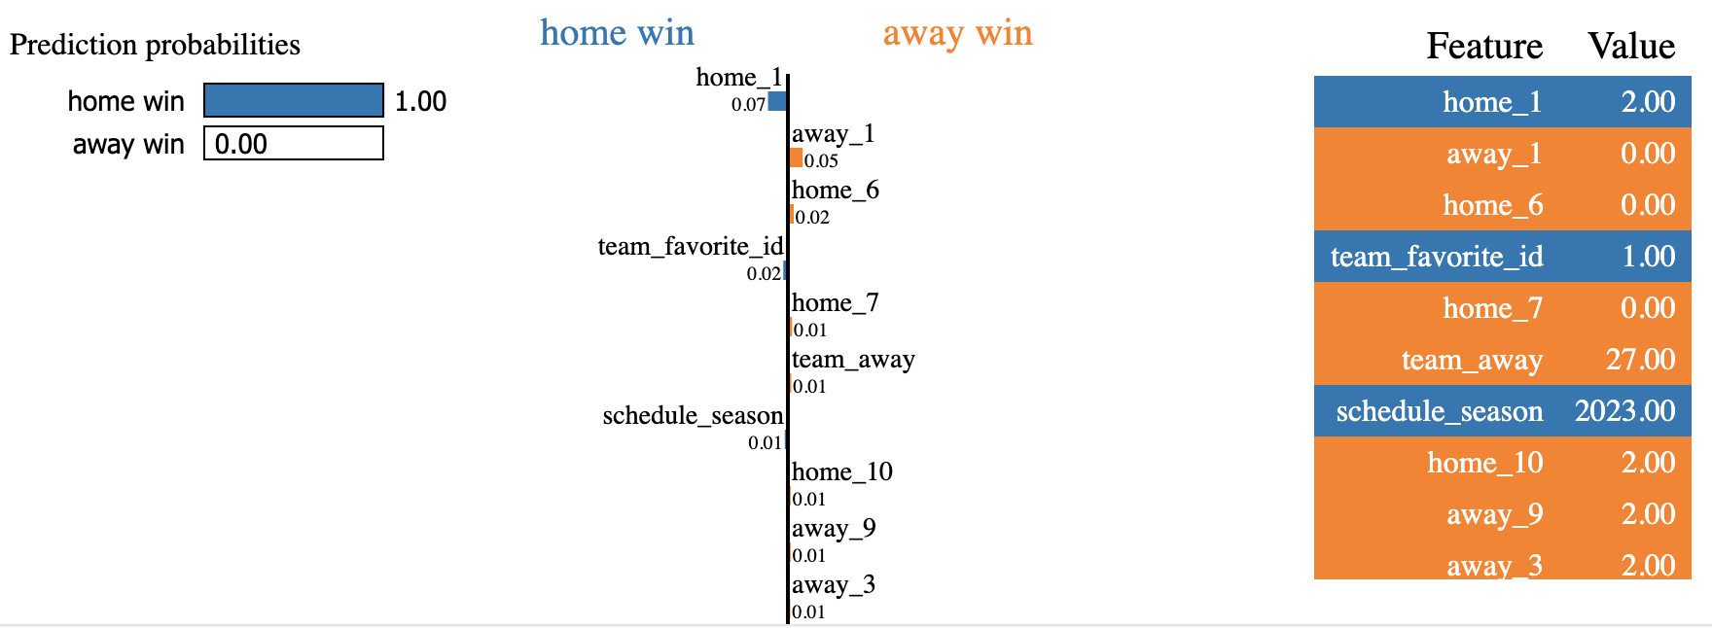
XGBoost & LIME
Average Rating 2.41/5.00

Slide 7
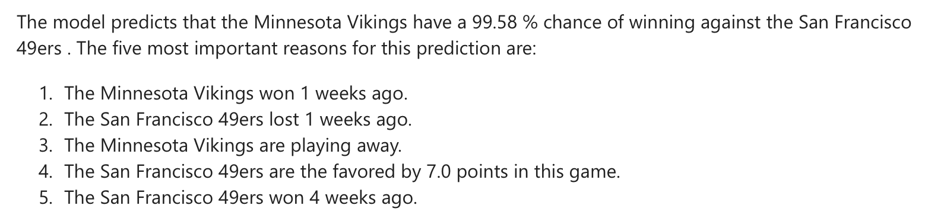
Textual Explanation based on XGBoost & LIME
Average Rating 3.41/5.00

Slide 8
Analysis and Findings
Textual explanation clearly favored and selected as top option by 55% of all participants
Participant feedback:
Textual explanation is easy to understand
Visualizations take longer to understand but hold more information
Improved labeling and legends might improve visualizations
No significant relationship between high/low AI knowledge and preferences
No significant relationship between high/low NFL knowledge and preferences

Slide 9







Further Research Ideas
IMPROVE EASE OF UNDERSTANDING OF EXISTING OUT-OF-THE-BOX EXPLANATION
USE LLMS TO GENERATE TEXTUAL EXPLANATIONS WITH MORE FLEXIBILITY
BE AWARE OF YOUR TARGET AUDIENCE WHEN DESIGNING EXPLAINABLE AI

